Slide 1
Energy Consumption Analysis Using Machine Learning.
Guide: DR. S .VIJAYA KUMAR.

Slide 2
Team members
Yogendra Naidu(21BTRCD028).
Prabal Dhar(21BTRCD056)
Sajjad Ali Dhuniya(21BTRCD064)
Chandon Kumar Roy Dipu(21BTRCD057)
Veerendra (21BTRCD038)
Amen H. Asfaw(21BTRCD058)

Slide 3
Abstract
The project aims to predict daily electricity demand using machine learning models.
The project uses a dataset that spans multiple years and has various factors affecting the demand.
The project first analyzes the data to find patterns, seasonality, and trends.
The project then creates predictors using automatic feature engineering techniques, which do not require strict statistical assumptions.
The project builds KNN and other models to forecast multiple steps ahead, and measures their accuracy using MAPE.

Slide 4
machine learning models :
Different machine learning models that can be used for energy consumption analysis. Some of the models are:
Multiple Linear Regression:
Random Forest Regressor:
Decision Tree Regressor:
Extreme Gradient Boosting Regressor:
Support Vector Machines:
K-Nearest Neighbor:
These are some of the machine learning models that can be used for energy consumption analysis. There may be other models that are not mentioned here.

Slide 5
Literature review.

Slide 6
Title | Author | Review | Limitation | Accuract
Machine Learning Approaches for Estimating Commercial Building Energy Consumption. | Caleb Robinsona, Bistra Dilkinaa,∗ , Jeffrey Hubbs, Wenwen Zhangb. Published on 15 December 2017 | This paper proposes a machine learning model to estimate commercial building energy consumption using only five commonly available features. The model is validated on external data from New York City and shows reasonable results. The authors also analyze the importance of different features in the model, which will serve to drive future data collection efforts. | Rade-off between accuracy and data requirements. Cannot capture the energy consumption patterns of extremely efficient or inefficient buildings | 99%
Energy Consumption Prediction Using Machine Learning . | Mohamad Nachawati. Published on 2022 | This project built and tested an LSTM model to predict energy consumption in Finland using a 6-year dataset. The model was trained on 100-day time steps and achieved good results on short-term predictions. | The model's performance is highly dependent on the number of time steps considered. Trained on a relatively short dataset.
Machine Learning Techniques in the Energy Consumption of Buildings: A Systematic Literature Review Using Text Mining and Bibliometric Analysis | AHMEDABDELAZIZ,VITOR SANTAS. Published on 22 November 2021. | Machine learning is transforming energy consumption analysis, enabling accurate predictions, anomaly detection, renewable energy integration, building energy management, demand response, grid optimization, and carbon footprint reduction. | Data Quality and Availability. Complexity and Interpretability. Model Overfitting. Dynamic and Non-linear Nature of Energy Systems.
Energy consumption prediction using machine learning. | Amir mosavi and Abdullah Bahmani. Published on 11 March 2019. | The use of machine learning models has increased in the last decade, with hybrid methods gaining popularity due to their ability to achieve higher accuracy and efficiency. The future direction of research is to develop hybrid models with even higher accuracy and speeds. | Complexity Interpretability Computational cost
Consumption & Prediction using Machine Learning Models. | Tapas R. Jena , Swati S. Barik, et al. Published on 2020 | The paper reviews various machine learning models for electricity consumption forecasting. Hybrid approaches, combining different models, are generally more promising, and accuracy improves with careful feature selection and hyperparameter tuning. | - Recent deep learning models are not covered in much detail. - More thorough empirical evaluation on standard public datasets | 95%

Slide 7
Problem Statement
Energy consumption is a major contributor to climate change and environmental degradation. It is also a significant expense for businesses and households. Machine learning (ML) can be used to develop powerful tools for energy consumption analysis, enabling more accurate and efficient predictions, identification of anomalies, and identification of opportunities for energy savings.
However, ML models can be complex and computationally expensive to develop and train. This can make them impractical for small projects or applications with limited resources.
Potential solutions:
Use a simple ML algorithm: A simple ML algorithm, such as linear regression or decision trees, may be sufficient for a small project. These algorithms are relatively easy to train and interpret and can be implemented on a regular laptop or desktop computer.
Use a feature engineering technique: Feature engineering transforms raw data into features that are more informative for the ML model. By carefully engineering the features, it is possible to improve the performance of a simple ML algorithm
on a small dataset.
Use a transfer learning approach: Transfer learning is a technique where a pre-trained ML model is
used as a starting point for a new ML model. This can be a useful approach for small projects,
as it can save time and resources in training the new model.

Slide 8
Project Proposed system.
Data Collection:
Gather relevant data from diverse sources, ensuring accuracy and completeness.
Data Preprocessing:
Clean, normalize, and transform data to remove inconsistencies and prepare it for analysis.
Feature Engineering:
Extract, select, or create meaningful features that enhance predictive power.
Model Selection:
Evaluate and choose suitable machine learning algorithms based
on data characteristics.

Slide 9
Model Training:
Train selected models on the preprocessed data using appropriate techniques.
Model Evaluation:
Assess model performance using metrics like MAPE, RMSE, and accuracy.
Hyper parameter Tuning:
Optimize model hyper parameters to improve predictive accuracy.
Interpretability:
Employ techniques like feature importance analysis to enhance model interpretability.
Deployment and Monitoring:
Implement the model in a real-world environment and continuously monitor its performance.
Documentation and Reporting:
Prepare comprehensive documentation and reports for stakeholders.

Slide 10
Architecture.
Collect and pre process energy consumption data
Extract features from the data
Start
Evaluate the model's performance on a held-out test set
Select and train a machine learning model
Deploy the model to production
End

Slide 11
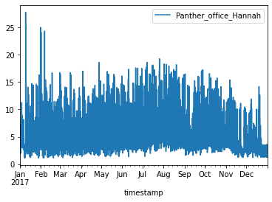
Result and Analysis
Data Used: BDG2 data set made up of 3,053 energy meters from 1,636 buildings.
Data Analysis: Involved encoding and plotting example data to observe the nature of the data

Slide 12
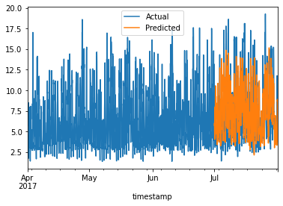
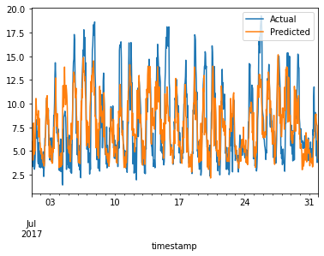
Result and Analysis
Model Building: Trained a model based on the KNN algorithm
Evaluate Model: Used different metrics and plots to evaluate the trained model with the test set.

Slide 13
Limitations
The models are only relevant to office, laboratories, classrooms, and dormitories from university campuses
More data from other buildings is needed to create a comprehensive benchmarking process.
New algorithms should be tested against the growing set of building data sets to quantify what improvements are being made.

Slide 14
Conclusion
This project demonstrates how machine learning is an effective instrument for identifying trends in energy use and creating predictive models for efficient energy use.
Although only office, laboratories, classrooms, and dormitories from university campuses are considered in the dataset, This gives us a starting point on building an efficient energy usage analysis method which is crucial in today's world.
By adding more variant datasets and experimenting with more complex model building methods this experiment can be further enhanced.

Slide 15
Thank You……

